Slide 1
Distributed Systems Mutual Exclusion

Slide 2

Need for Mutual Exclusion
Distributed processes need to coordinate to access shared resources
Example: Writing a file in a Distributed File System
Client A
Client C
Server
Write to file abc.txt
Read from file abc.txt
P1
Distributed
File
abc.txt
P3
Client B
P2
Write to file abc.txt
In uniprocessor systems, mutual exclusion to a shared resource is provided through shared variables or operating system support.
However, such support is insufficient to enable mutual exclusion of distributed entities
In Distributed System, processes coordinate access to a shared resource by passing messages to enforce distributed mutual exclusion
‹#›

Slide 3


Types of Distributed Mutual Exclusion
Mutual exclusion algorithms are classified into two categories
Permission-based Approaches
A process, which wants to access a shared resource, requests the permission from one or more coordinators
Token-based Approaches
Each shared resource has a token
Token is circulated among all the processes
A process can access the resource if it has the token
Request to access
Coordinator
Client 1
C1
Grant
Server
P1
Access
Resource
Server
Resource
Access
Access
Client 1
Client 2
Client 3
Access
P1
P2
P3
Token
Token
Token
‹#›

Slide 4
Overview
Time Synchronization
Clock Synchronization
Logical Clock Synchronization
Mutual Exclusion
Permission-based Approaches
Token-based Approaches
Election Algorithms
‹#›

Slide 5
Permission-based Approaches
There are two types of permission-based mutual exclusion algorithms
Centralized Algorithms
Decentralized Algorithms
We will study an example of each type of algorithm
‹#›

Slide 6

a. A Centralized Algorithm
One process is elected as a coordinator (C) for a shared resource
Coordinator maintains a Queue of access requests
Whenever a process wants to access the resource, it sends a request message to the coordinator to access the resource
When the coordinator receives the request:
If no other process is currently accessing the resource, it grants the permission to the process by sending a “grant” message
If another process is accessing the resource, the coordinator queues the request, and does not reply to the request
The process releases the exclusive access after accessing the resource
The coordinator will then send the “grant” message to the next process in the queue
P0
P1
P2
Rel
Req
Grant
Grant
Access
Req
Access
Resource
C
P2
P1
Queue
‹#›

Slide 7
Discussion about Centralized Algorithm
Blocking vs. non-blocking requests
The coordinator can block the requesting process until the resource is free
Otherwise, the coordinator can send a “permission-denied” message back to the process
The process can poll the coordinator at a later time, or
The coordinator queues the request. Once the resource is released, the coordinator will send an explicit “grant” message to the process
The algorithm guarantees mutual exclusion, and is simple to implement
Fault-tolerance:
Centralized algorithm is vulnerable to a single-point of failure (at coordinator)
Processes cannot distinguish between dead coordinator and request blocking
Performance bottle-neck:
In a large system, single coordinator can be overwhelmed with requests
‹#›

Slide 8
b. A Decentralized Algorithm
To avoid the drawbacks of the centralized algorithm, Lin et al. [1] advocated a decentralized mutual exclusion algorithm
Assumptions
Distributed processes are in a Distributed Hash Table (DHT) based system
Each resource is replicated n times
The i^{th} replica of a resource rname is named as rname-i
Every replica has its own coordinator for controlling access
The coordinator for rname-i is determined by using a hash function
Approach:
Whenever a process wants to access the resource, it will have to get a majority vote from m > n/2 coordinators
If a coordinator does not want to vote for a process (because it has already voted for another process), it will send a “permission-denied” message to the process
‹#›

Slide 9




A Decentralized Algorithm – An Example
If n=10 and m=7, then a process needs at-least 7 votes to access the resource
C1
rname-1
Req
Access
C2
rname-2
7
OK
0
1
2
3
4
5
6
P0
C3
rname-3
C4
rname-4
Req
0
C5
rname-5
1
2
3
P1
OK
Deny
C6
rname-6
Deny
C7
rname-7
C8
rname-8
C9
rname-9
C10
rname-10
xth replica
= of a resource
rname
rname-x
Cj
= Coordinator j
Pi
= Process i
n
= Number of votes gained
‹#›
Notes:
‹#›

Slide 10
Fault-tolerance in Decentralized Algorithm
The decentralized algorithm assumes that the coordinator recovers quickly from a failure
However, the coordinator would have reset its state after recovery
Coordinator could have forgotten any vote it had given earlier
Hence, the coordinator may incorrectly grant permission to the processes
Mutual exclusion cannot be deterministically guaranteed
But, the algorithm probabilistically guarantees mutual exclusion
‹#›

Slide 11

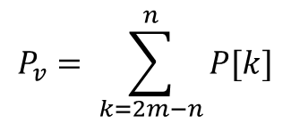
Probabilistic Guarantees in the Decentralized Algorithm
What is the minimum number of coordinators who should fail for violating mutual exclusion?
At least 2m-n coordinators should fail
Let the probability of violating mutual exclusion be P_{v}
Derivation of P_{v}
Let T be the lifetime of the coordinator
Let p=Δt/T be the probability that coordinator crashes during time-interval Δt
Let P[k] be the probability that k out of m coordinators crash during the same interval
We compute the mutual exclusion violation probability P_{v} by:
In practice, this probability should be very small
For T=3 hours, Δt=10 s, n=32, and m=0.75n : P_{v} =10⁻⁴⁰
‹#›

Slide 12
Overview
Time Synchronization
Clock Synchronization
Logical Clock Synchronization
Mutual Exclusion
Permission-based Approaches
Token-based Approaches
Election Algorithms
‹#›

Slide 13

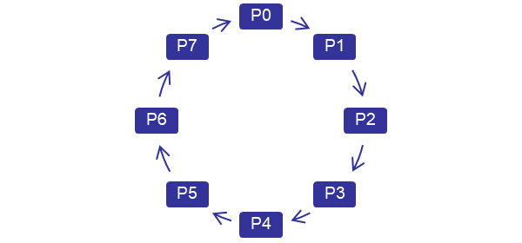
Token Ring
In the Token Ring algorithm, each resource is associated with a token
The token is circulated among the processes
The process with the token can access the resource
Circulating the token among processes:
All processes form a logical ring where each process knows its next process
One process is given a token to access the resource
The process with the token has the right to access the resource
If the process has finished accessing the resource OR does not want to access the resource:
it passes the token to the next process in the ring
Resource
T
Access
T
T
‹#›

Slide 14
Discussion about Token Ring
Token ring approach provides deterministic mutual exclusion
There is one token, and the resource cannot be accessed without a token
Token ring approach avoids starvation
Each process will receive the token
Token ring has a high-message overhead
When no processes need the resource, the token circulates at a high-speed
If the token is lost, it must be regenerated
Detecting the loss of token is difficult since the amount of time between successive appearances of the token is unbounded
Dead processes must be purged from the ring
ACK based token delivery can assist in purging dead processes
‹#›

Slide 15
Comparison of Mutual Exclusion Algorithms
Algorithm | Delay before a process can access the resource (in message times) | Number of messages required for a process to access and release the shared resource | Problems
Centralized
Decentralized
Token Ring
2
3
Coordinator crashes
2mk
2mk + m; k=1,2,…
Large number of messages
1 to ∞
Token may be lost
Ring can cease to exist since processes crash
0 to (n-1)
Assume that:
n = Number of processes in the distributed system
For the Decentralized algorithm:
m = minimum number of coordinators who have to agree for a process to access a resource
k = average number of requests made by the process to a coordinator to request for a vote
‹#›

Slide 16
Overview
Time Synchronization
Clock Synchronization
Logical Clock Synchronization
Mutual Exclusion
Permission-based Approaches
Token-based Approaches
Election Algorithms
‹#›

Slide 17








Election in Distributed Systems
Many distributed algorithms require one process to act as a coordinator
Typically, it does not matter which process is elected as the coordinator
Example algorithms where coordinator election is required
Coordinator
Time server
Client 1
C1
P1
Server
Resource
Berkeley Clock Synchronization Algorithm
A Centralized Mutual Exclusion Algorithm
‹#›

Slide 18
Election Process
Any process P_{i} in the DS can initiate the election algorithm that elects a new coordinator
At the termination of the election algorithm, the elected coordinator process should be unique
Every process may know the process ID of every other processes, but it does not know which processes have crashed
Generally, we require that the coordinator is the process with the largest process ID
The idea can be extended to elect best coordinator
Example: Election of a coordinator with least computational load
If the computational load of process P_{i} denoted by load_{i}, then coordinator is the process with highest 1/load_{i.} Ties are broken by sorting process ID.
‹#›

Slide 19
Election Algorithms
We will study two election algorithms
Bully Algorithm
Ring Algorithm
‹#›

Slide 20
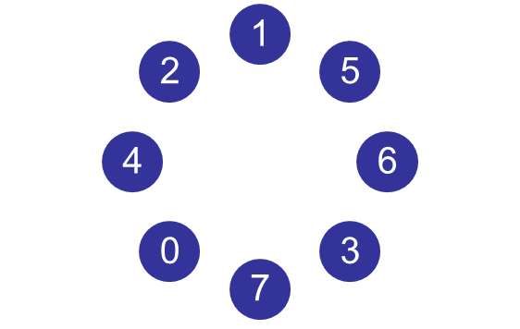

1. Bully Algorithm
A process initiates election algorithm when it notices that the existing coordinator is not responding
Process P_{i} calls for an election as follows:
P_{i} sends an “Election” message to all processes with higher process IDs
When process P_{j} with j>i receives the message, it responds with a “Take-over” message. P_{j} no more contests in the election
Process P_{j} re-initiates another call for election. Steps 1 and 2 continue
If no one responds, P_{i} wins the election. P_{i} sends “Coordinator” message to every process
Take-Over
Election
Election
Take-Over
Election
Coordinator
Take-over
Election
Election
Election
X
‹#›

Slide 21
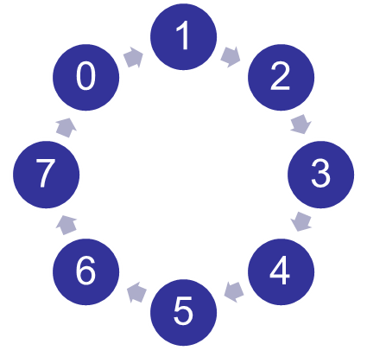

2. Ring Algorithm
This algorithm is generally used in a ring topology
When a process P_{i} detects that the coordinator has crashed, it initiates an election algorithm
P_{i} builds an “Election” message (E), and sends it to its next node. It inserts its ID into the Election message
When process P_{j} receives the message, it appends its ID and forwards the message
If the next node has crashed, P_{j} finds the next alive node
When the message gets back to the process that started the election:
it elects process with highest ID as coordinator, and
changes the message type to “Coordination” message (C) and circulates it in the ring
E: 5,6,0
C: 6
E: 5,6,0,1
C: 6
X
E: 5,6,0,1,2
C: 6
E: 5,6
C: 6
E: 5,6,0,1,2,3
C: 6
E: 5
C: 6
E: 5,6,0,1,2,3,4
C: 6
‹#›

Slide 22
Comparison of Election Algorithms
Algorithm | Number of Messages for Electing a Coordinator | Problems
Bully Algorithm
Ring Algorithm
O(n²)
Large message overhead
2n
An overlay ring topology is necessary
Assume that:
n = Number of processes in the distributed system
‹#›

Slide 23
Summary of Election Algorithms
Election algorithms are used for choosing a unique process that will coordinate an activity
At the end of the election algorithm, all nodes should uniquely identify the coordinator
We studied two algorithms for election
Bully algorithm
Processes communicate in a distributed manner to elect a coordinator
Ring algorithm
Processes in a ring topology circulate election messages to choose a coordinator
‹#›

Slide 24
References
[1] Shi-Ding Lin, Qiao Lian, Ming Chen and Zheng Zhang, “A Practical Distributed Mutual Exclusion Protocol in Dynamic Peer-to-Peer Systems”, Lecture Notes in Computer Science, 2005, Volume 3279/2005, 11-21, DOI: 10.1007/978-3-540-30183-7_2
[2] http://en.wikipedia.org/wiki/Causality
‹#›

Slide 25
Election in Large Scale Networks
Bully Algorithm and Ring Algorithm does scales poorly with the size of the network
Bully Algorithm needs O(n²) messages
Ring Algorithm requires maintaining a ring topology and requires 2n messages to elect a leader
In large networks, these approaches do not scale
We discuss a scalable election algorithm for large scale peer-to-peer networks
‹#›

Slide 26
Election in Large Scale Peer-to-Peer Networks
Many P2P networks have a hierarchical architecture for balancing the advantages between centralized and distributed networks
Many peer-to-peer networks are neither completely unstructured nor completely centralized
Centralized networks are efficient and, they easily facilitate locate entities and data (e.g., name spaces)
Flat unstructured peer-to-peer networks are robust, autonomous and balances load between all peers
‹#›

Slide 27
Super-peer
In large unstructured Peer-to-Peer Networks, the network is organized into peers and super-peers
Super-Peers are entities that not only participate as a peer, but also take on additional role of acting as a leader for a set of peers
Super-peer acts as a server for a set of client peers
All communication from and to a regular peer proceeds through a super-peer
It is expected that super-peers are long-lived nodes with high-availability
Super Peer
Regular Peer
Super-Peer Network
‹#›

Slide 28
Super-Peer – Election Requirements
In a hierarchical P2P network, several nodes have to be selected as super-peers
Traditionally, only one node was selected as a coordinator
Requirements for a node being elected as super-peer
Super-peers should be evenly distributed across the overlay network
There should be a predefined proportion of super-peers relative to the number of regular peers
Each super-peer should not need to serve more than a fixed number of regular peers
‹#›

Slide 29
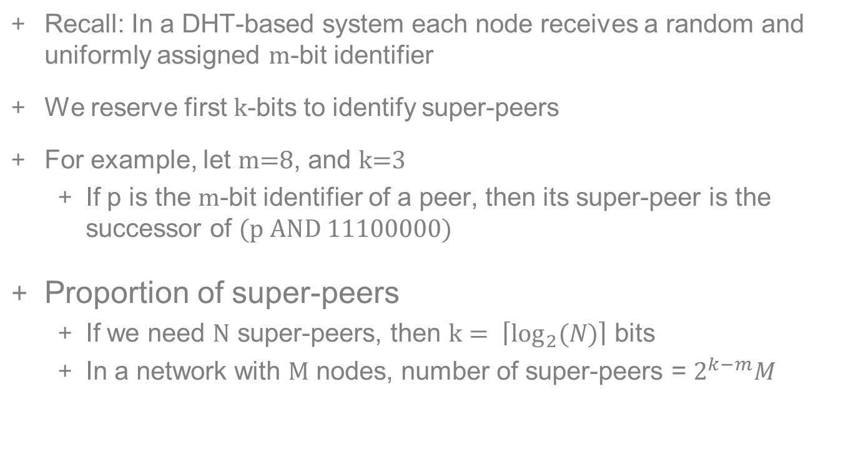
Election of Super-peers in a DHT-based system
m
‹#›
k

Slide 30











Election Algorithms
Many distributed algorithms require one process to act as a coordinator
Typically, it does not matter which process is elected as the coordinator
Root note selection in Multicasting
Home Node Selection in Naming
Coordinator
Time server
Client 1
C1
P1
Server
Resource
Berkeley Clock Synchronization Algorithm
A Centralized Mutual Exclusion Algorithm
‹#›

Slide 31
Comparison of Mutual Exclusion Algorithms
Algorithm | Delay before a process can access the resource (in message times) | Number of messages required for a process to access and release the shared resource | Problems
Centralized
Decentralized
Token Ring
Assume that:
n = Number of processes in the distributed system
For the Decentralized algorithm:
m = minimum number of coordinators who have to agree for a process to access a resource
k = average number of requests made by the process to a coordinator to request for a vote
‹#›

Slide 32
Comparison of Election Algorithms
Algorithm | Number of Messages for Electing a Coordinator | Problems
Bully Algorithm
Ring Algorithm
Assume that:
n = Number of processes in the distributed system
‹#›

